Slide 1
Feature Engineering
Data Wrangling

Slide 2
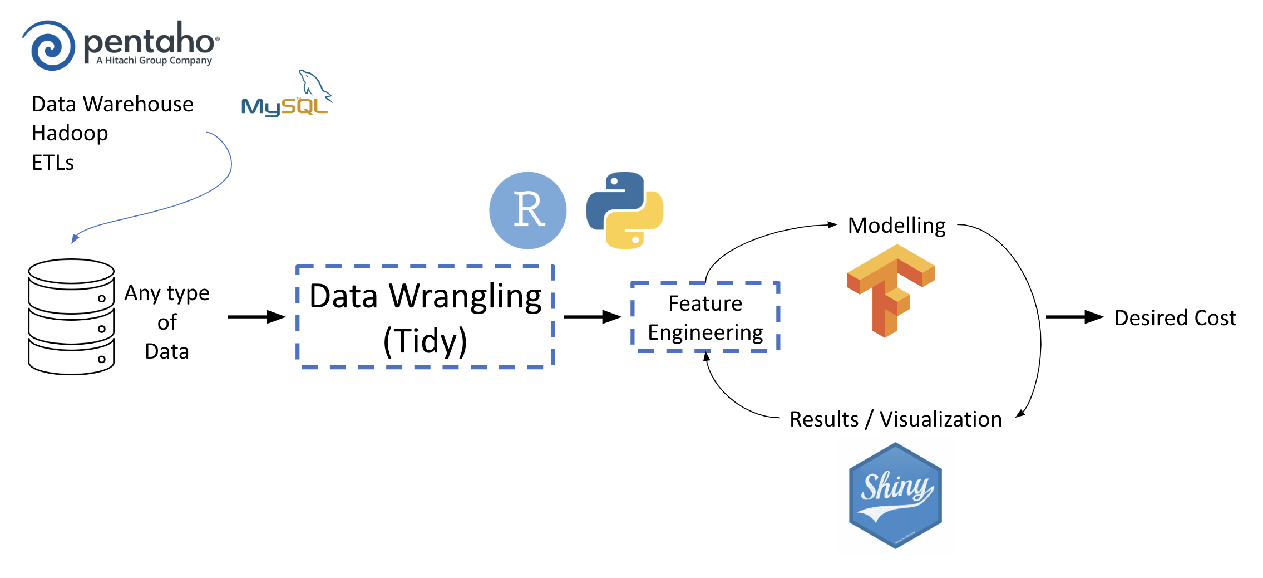
… from the first session

Slide 3
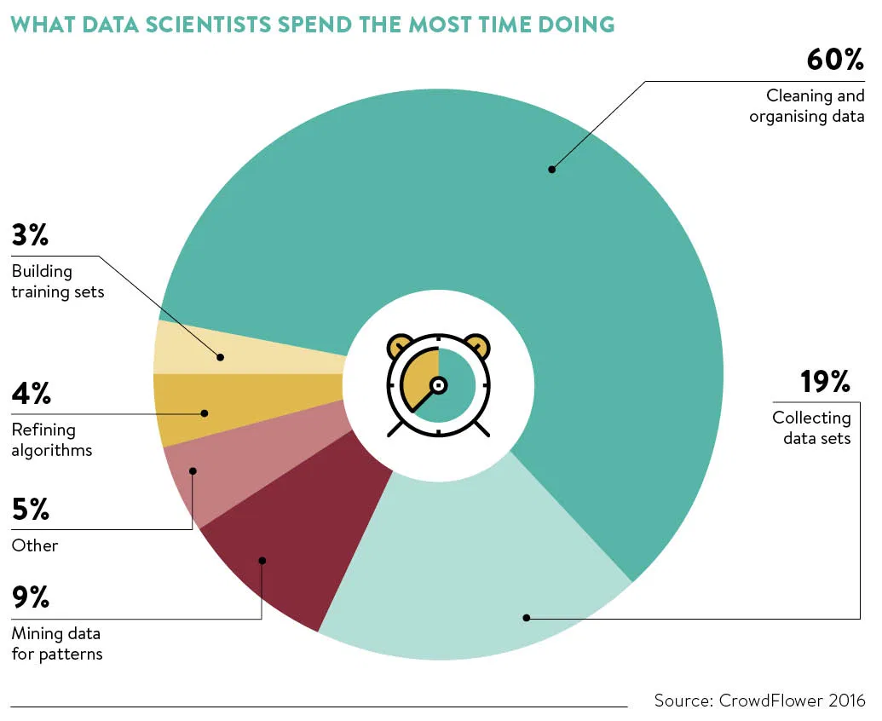
What data scientists spend the most time doing...

Slide 4
Agenda
1. Missing Data
1.1 Deletion
1.2 Filling and dropping values
1.3 Imputations and Sectorized Imputations
1.4 Prediction models
2. Outliers
3. Normalization (Numerical variables)
3.1 Standardization (Z value)
3.2 Scalers
3.3 Bins
3.4 Log transformations
4. Embeddings (Categorical variables)
4.1 Label encoding
4.2 One hot encoding
4.3 GloVe (Global Vectors)
4.4 Skipgrams and Bag of Words
5. Splitting Sets
5.1 Train, test and validation sets

Slide 5
Agenda
1
Missing Data
2
Outliers
3
Normalization (Numerical Variables)
4
Embeddings (Categorical Variables)
5
Splitting Sets

Slide 6
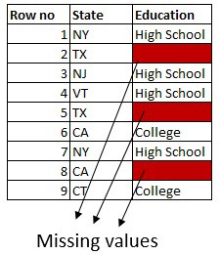
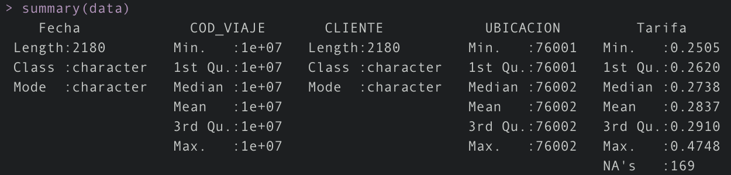
Dealing with Missing Data
NA
NULL
<blank>
0, 99, 999
Are NA and <blank> the same?
Can we handle missing data as part of the test set?
Some ML, DL... algorithms drop NA values… some give errors

Slide 7
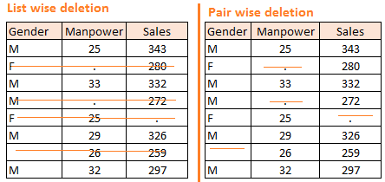
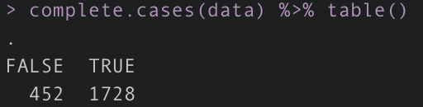
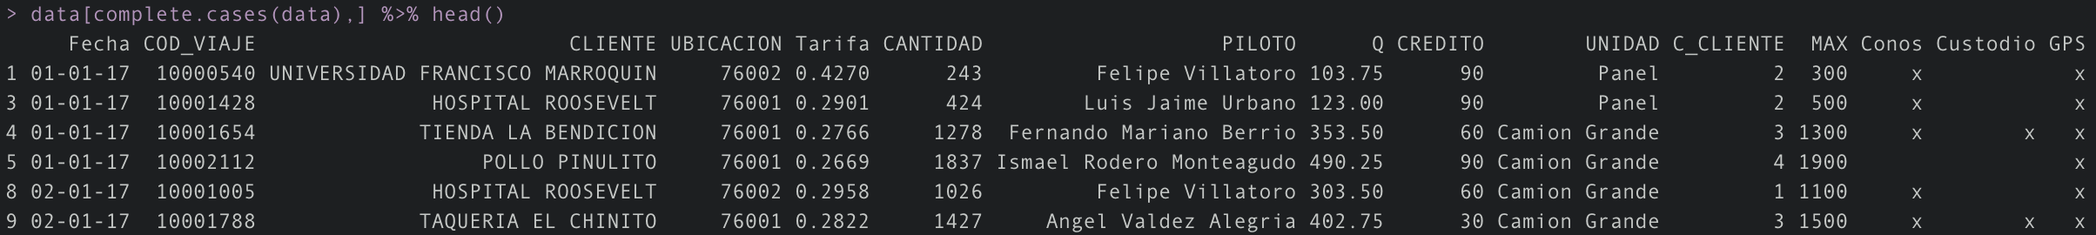
Deletion - Listwise
When to use listwise deletion?
Data is not entirely available
Biased sample or results
You have sufficient data already
Probability to get a missing value is unrelated (MCAR)
Missing key features of observation
Advantages: Very easy to implement in any language
Disadvantages: Losing observations
Notes:
NA or <blank>? Complete.cases only filters out NAs or NULL values. It leaves <blank> values.
You can use other functions, dplyr filters, even Regex to solve it. It only takes a vector of logical values.
MCAR → missing completely at random → gets lost in the mail. Group by missing and complete data and characteristics should match.

Slide 8
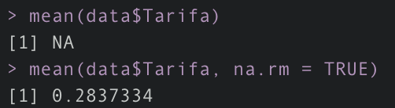
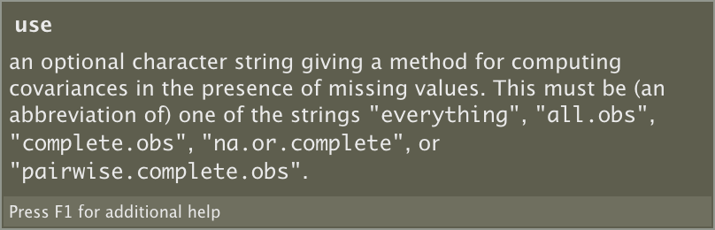
Deletion - Pairwise
When to use pairwise deletion?
Correlation between multiple values
Want to use all data available
Don’t have much data
Advantages: Not losing observations. Using all data I collected.
Disadvantages: Features with different size and meaning
Notes:
For each pair of variables for which data is available, the correlation coefficient will take that data into account. Thus, pairwise deletion maximizes all data available by an analysis by analysis basis. A strength to this technique is that it increases power in your analyses.
In a correlation, the observation that is missing the gender will be used if I select Manpower and Sales.

Slide 9
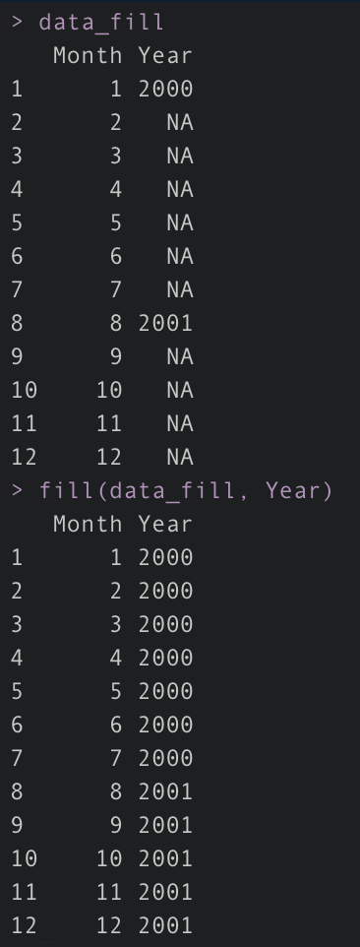
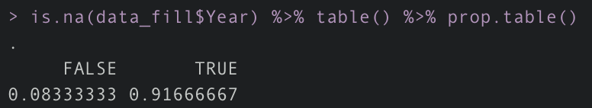
Filling and dropping values
Filling Values
Fill values with information available (time series for example)
Nearest Neighbor Imputation (NNI) - surveys - distance minimization
KNN models
Advantages: Not losing observations.
Disadvantages: Missing the target
Dropping Values
Dropping features lower than a threshold (70% for example)
Advantages: Not using features with many NA. Can alter our model.
Disadvantages: Losing information
Notes:
We’re adding additional errors to our data not only from the final model but also Missing Data models.

Slide 10
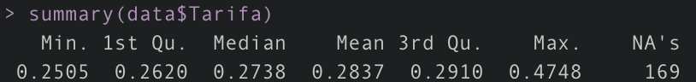
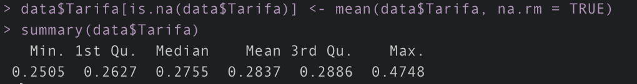
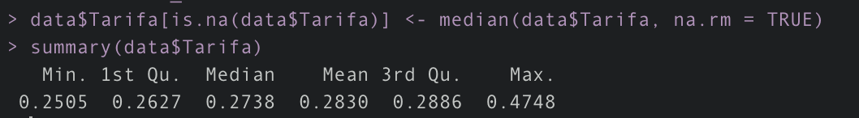
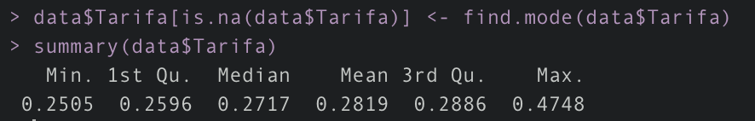
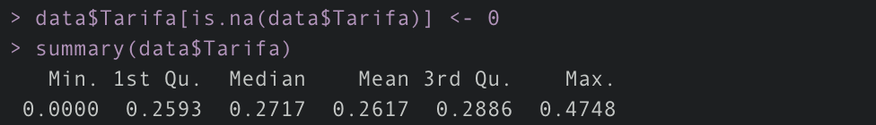
Imputations - mean/mode/median and 0
Mean: maintains the average of each feature
Mode: most repeated value (stats change)
Median: median value (stats change)
Constant: Adding a constant to all missing values (stats changes but functions become available without na.rm)
Original
Mean
Median
Mode
Zero

Slide 11
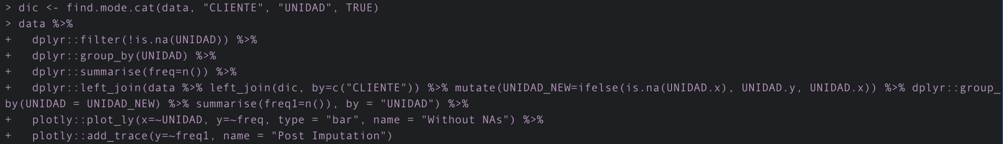
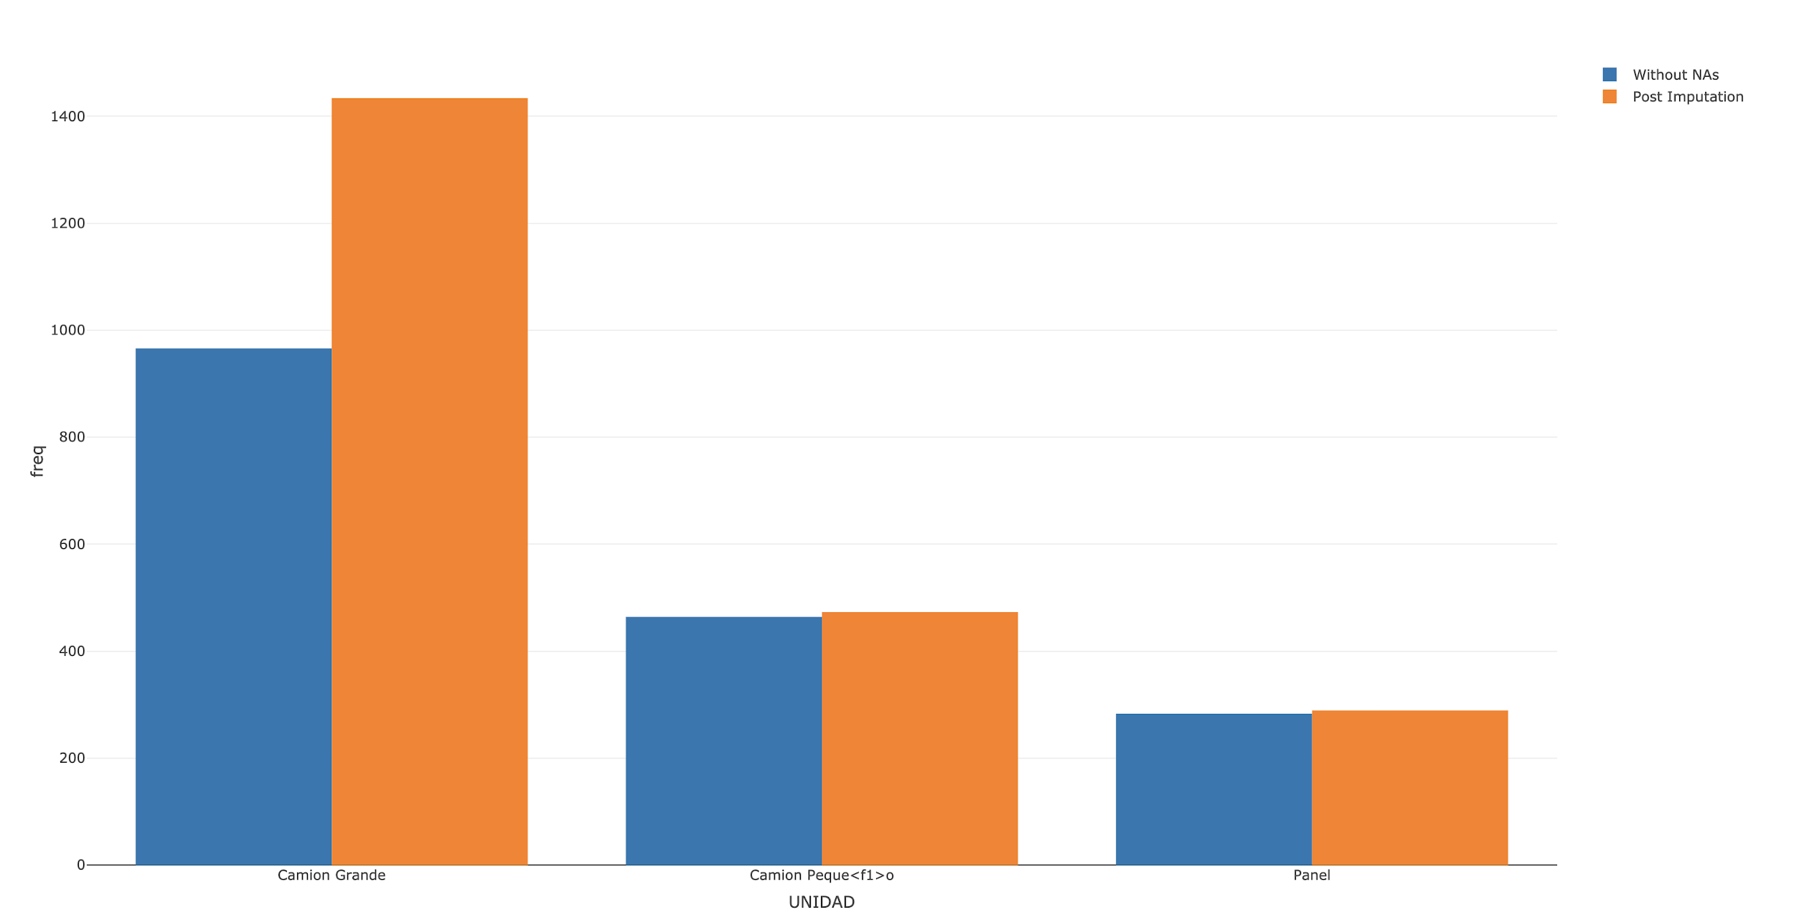
Categorical and Sectorized Imputations
Using mean/mode/median or 0 imputation by feature.
Mode is needed for categorical features
Disadvantage: Data is now highly biased

Slide 12
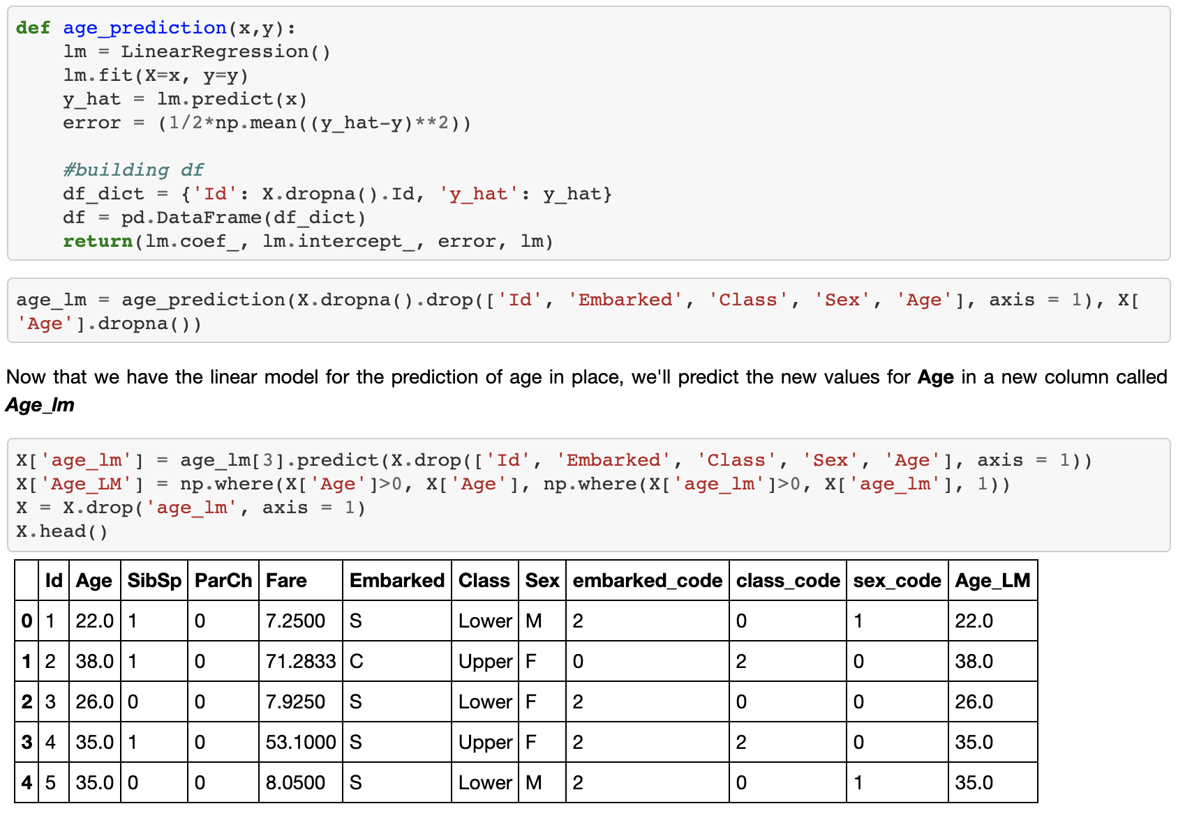
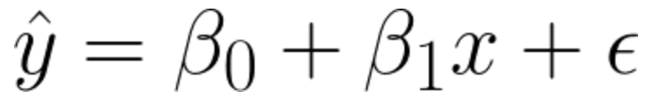
Predictive models
Predictive models are used to choose the best approximation for a missing value.
Numerical features:
Linear regression
Multidimensional regression
Categorial features:
K-Nearest neighbors (KNN)
Support vector machines (SVM)
Logistic regression

Slide 13
Agenda
1
Missing Data
2
Outliers
3
Normalization (Numerical Variables)
4
Embeddings (Categorical Variables)
5
Splitting Sets

Slide 14
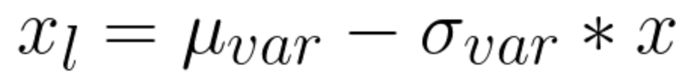
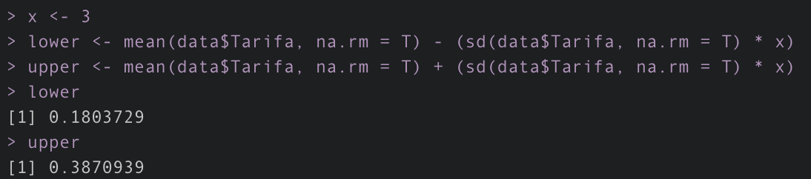
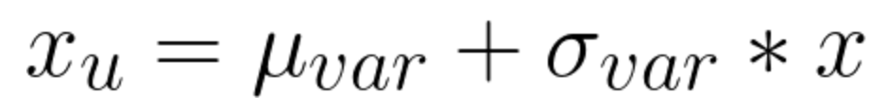
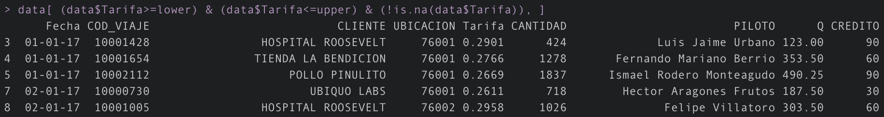
Outliers - Standard deviation approach
All values with a distance to the average of factor * standard deviation are assumed to be outliers.
How we choose a factor? (2-4 recommended) *We can also use Z value
We can drop the Outliers from our data or we can “Cap” those values. For the observations with a value under the lower limit, we use the lower limit instead; the same for the upper values.
Notes:
Not null assumption:
data$Tarifa[data$Tarifa < lower] <- lower
data$Tarifa[data$Tarifa > upper] <- upper

Slide 15
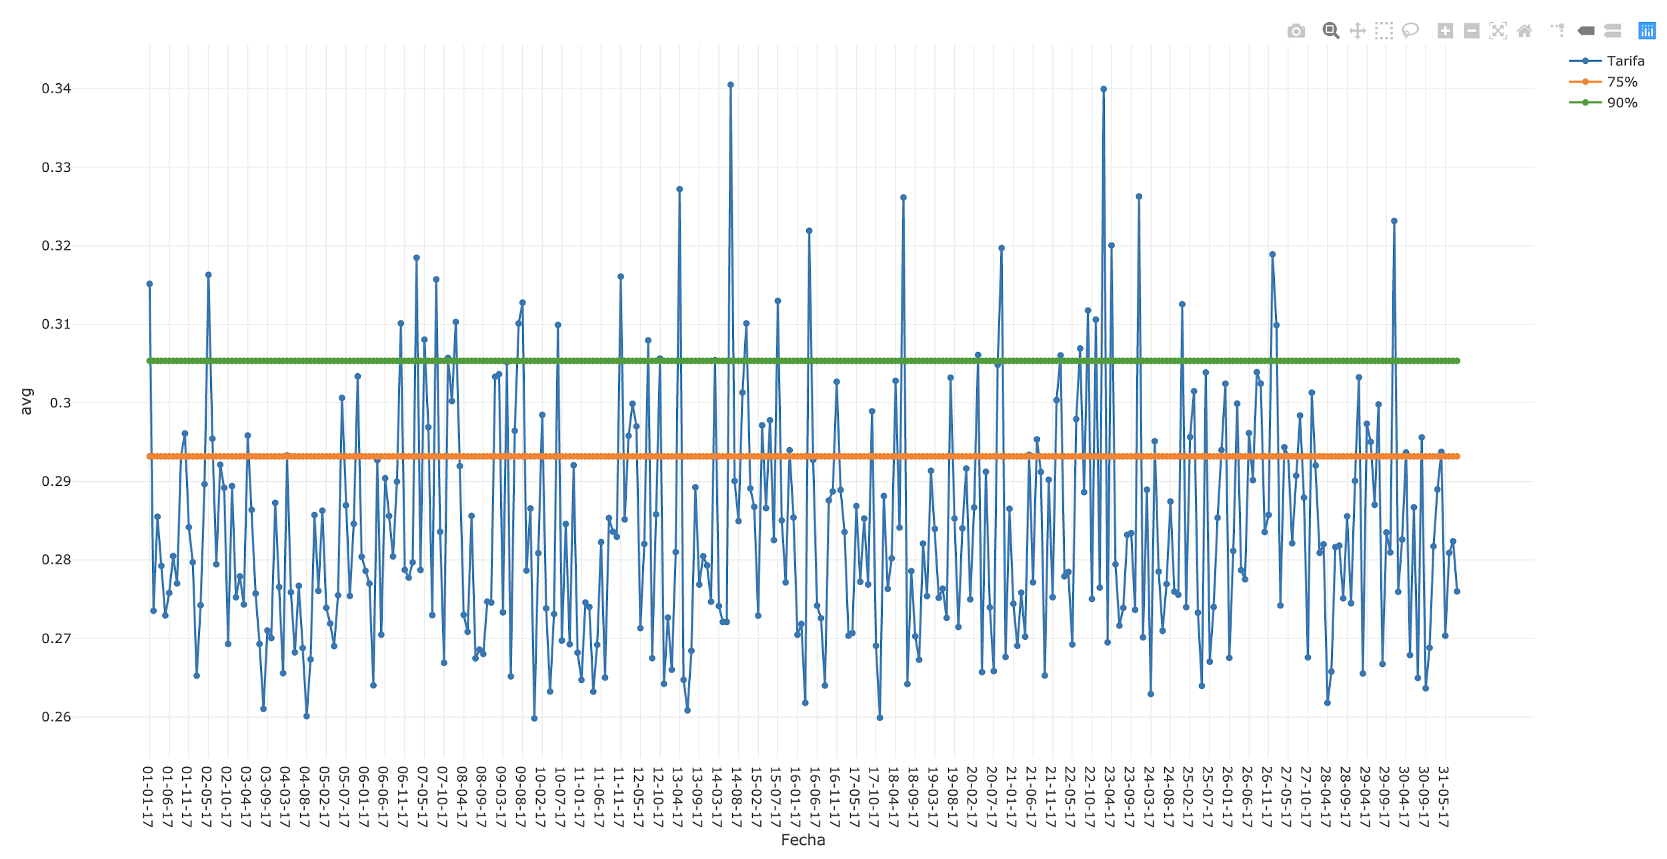
Outliers - Percentile approach

Slide 16
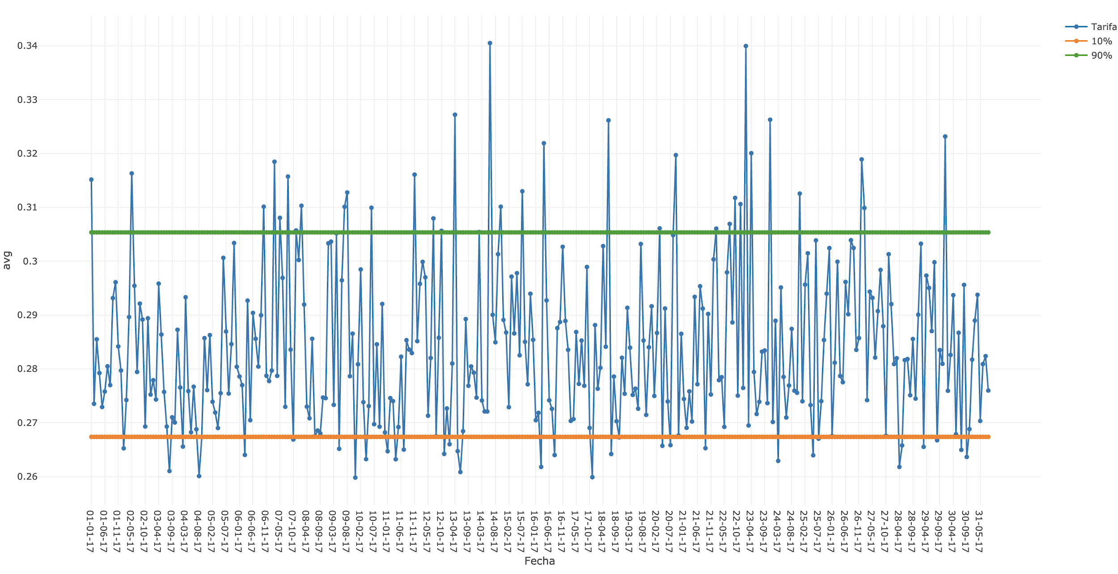
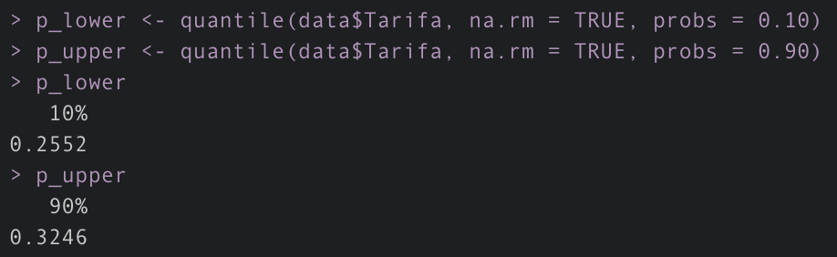
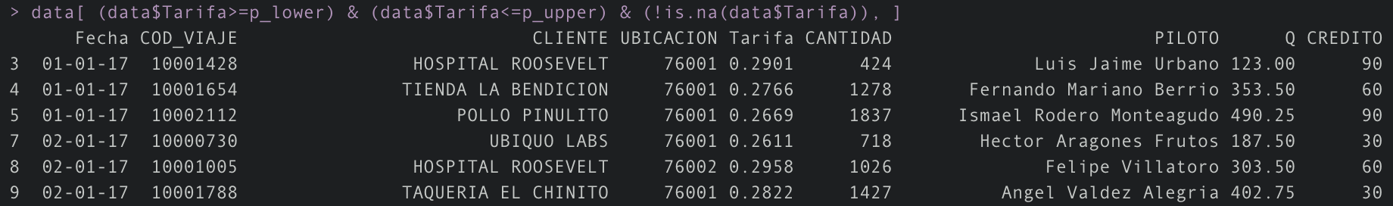
Outliers - Percentile approach

Slide 17
Agenda
1
Missing Data
2
Outliers
3
Normalization (Numerical Variables)
4
Embeddings (Categorical Variables)
5
Splitting Sets
Notes:
Should we always scale our features?
Is there a single best scaling technique?
How different scaling techniques affect different classifiers?
Should we consider scaling technique as an important hyperparameter of our model?

Slide 18
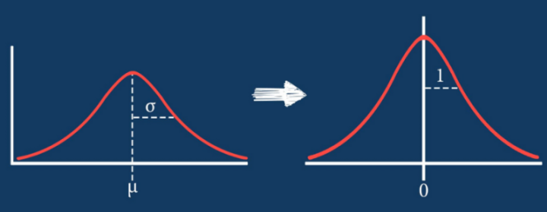
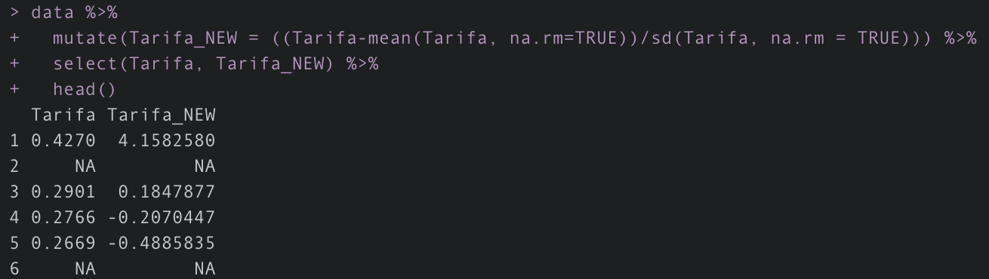
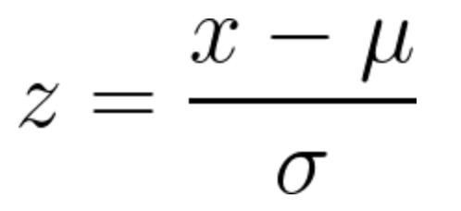
Standardization (Z value)

Slide 19
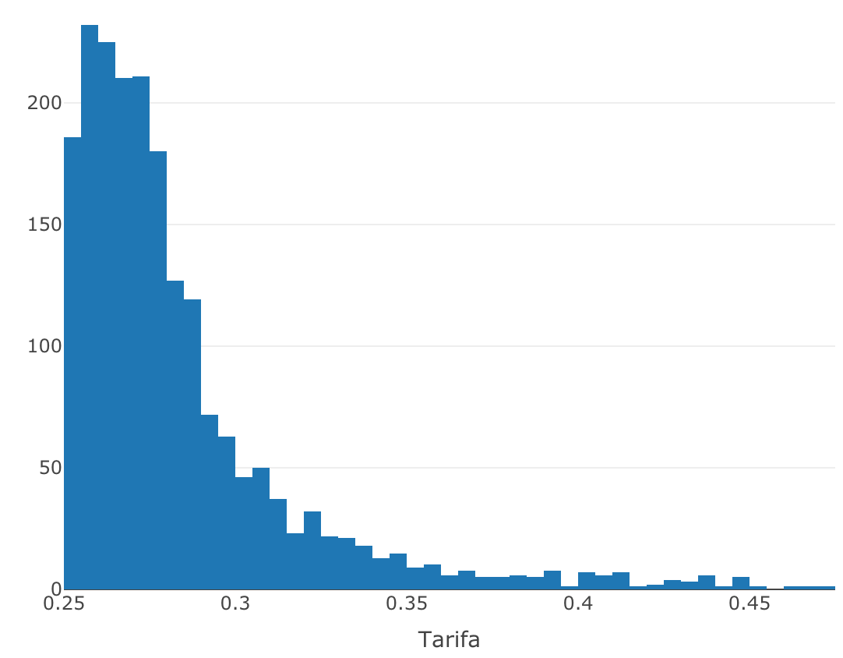
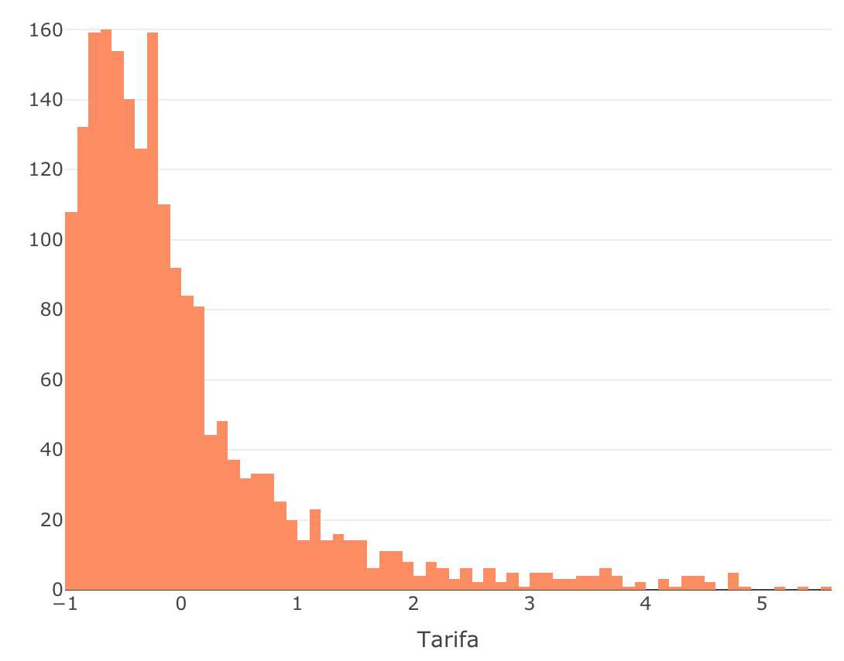
Standardization (Z value)
Original Histogram
Standardized Histogram

Slide 20
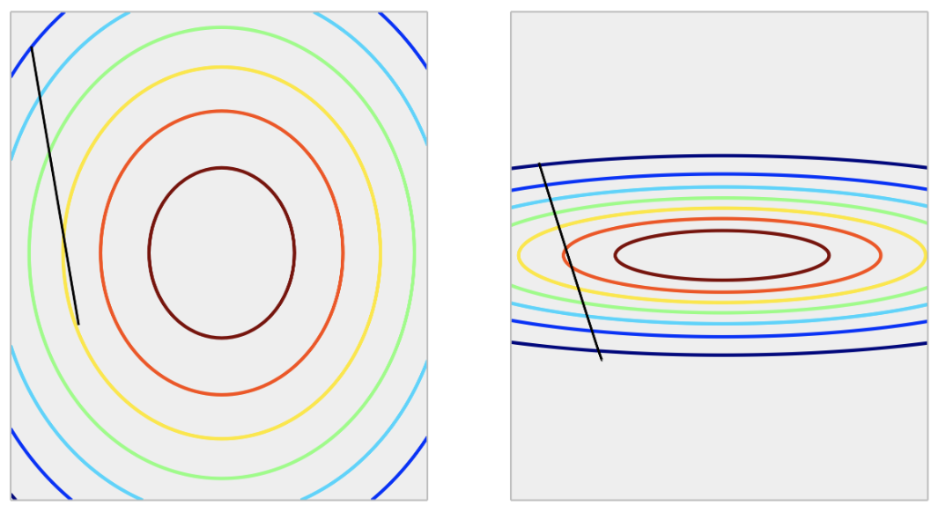
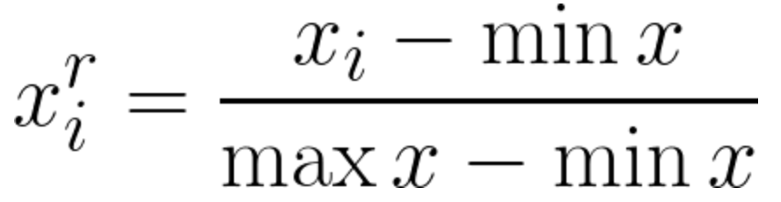
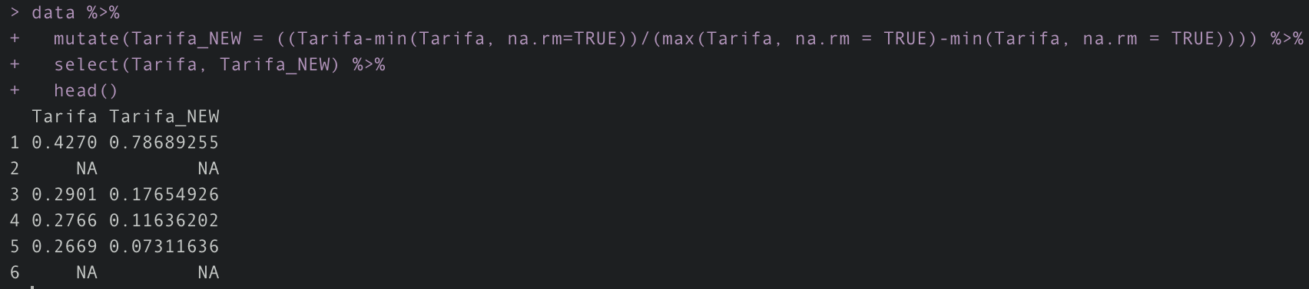
Min Max Scaling (Normalization)
Rescales feature values from 0 to 1
Poorly scaled function

Slide 21
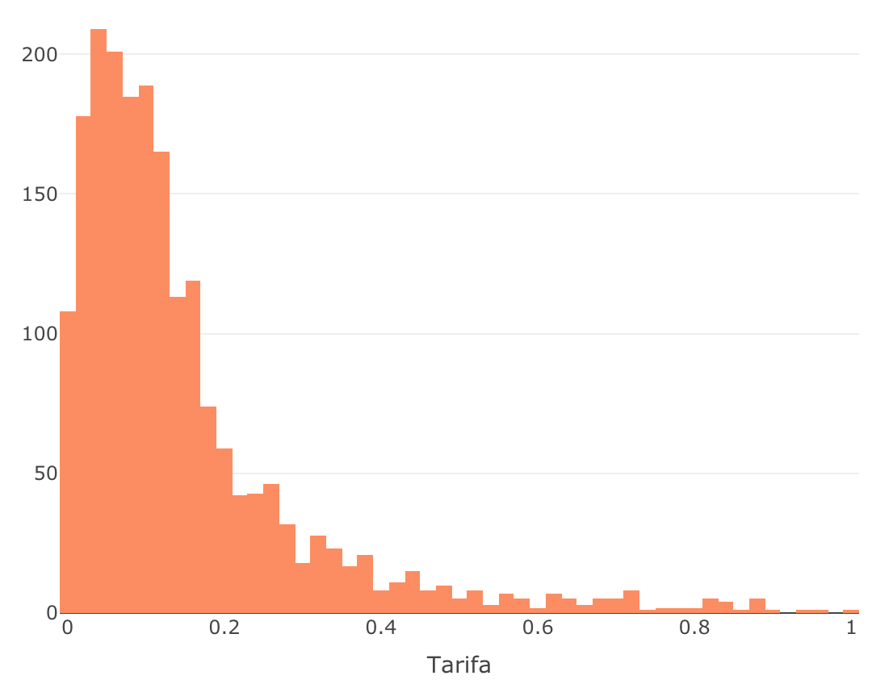
Min Max Scaling (Normalization)
Original Histogram
Normalized Histogram

Slide 22
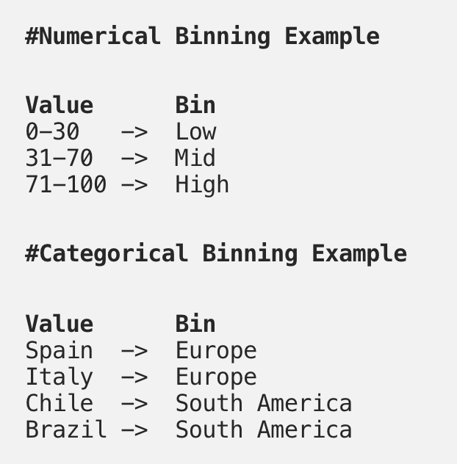
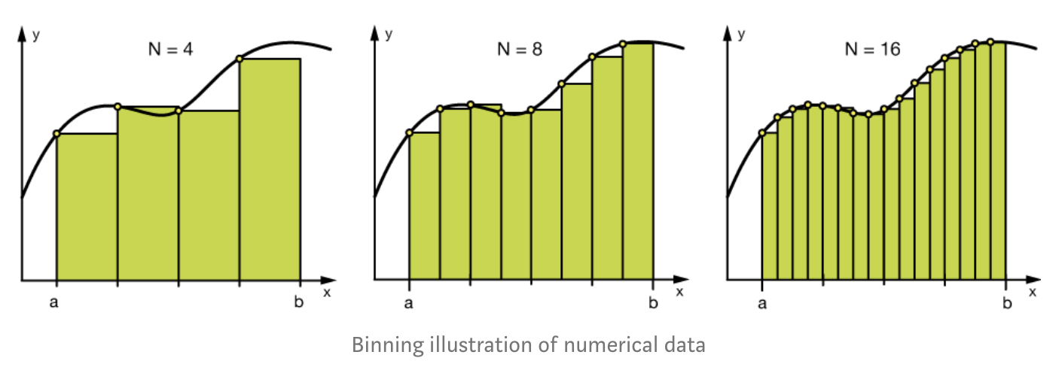
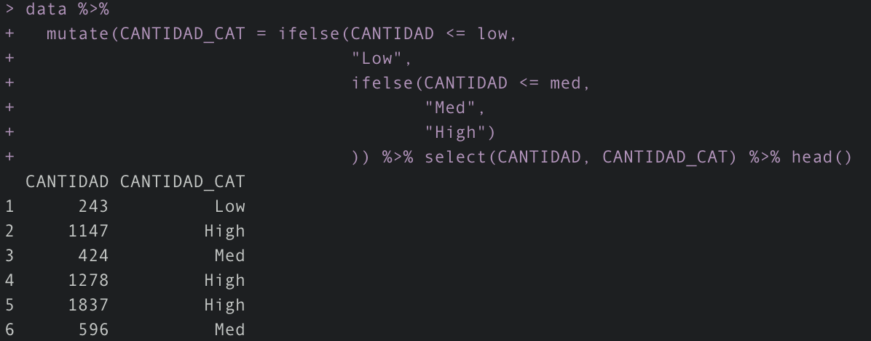
Bins
Helps preventing overfitting
Adds additional features to the model to understand the data
Splitting into columns
Notes:
Splitting into columns:
We enable machine learning algorithms to comprehend them.
Make possible to bin and group them.
Improve model performance by uncovering potential information.

Slide 23
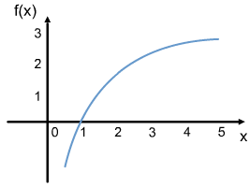
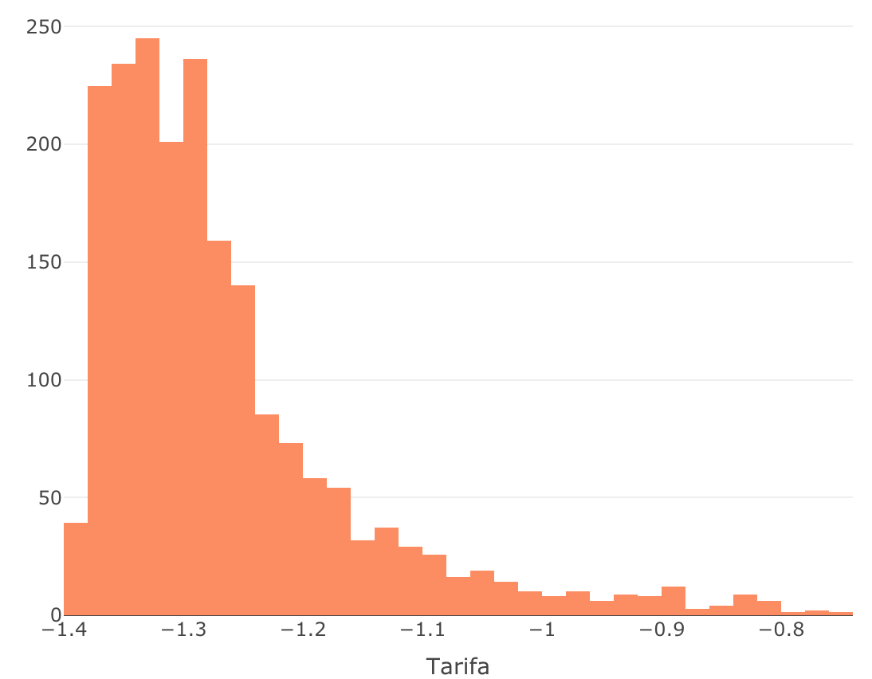
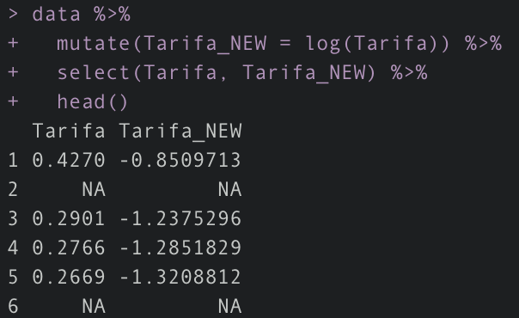
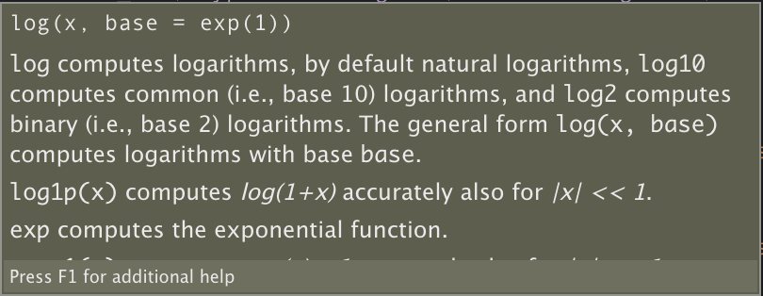
Log Transformations
Logarithmic transformation (only positive values)
Helps with skew features
Features closer to normal distribution
Some differences in a feature are not linear; age for example.
Log transformation
Notes:
The difference between ages 15 and 20 is not equal to the ages 65 and 70. In terms of years, yes, they are identical, but for all other aspects, 5 years of difference in young ages mean a higher magnitude difference.

Slide 24
Agenda
1
Missing Data
2
Outliers
3
Normalization (Numerical Variables)
4
Embeddings (Categorical Variables)
5
Splitting Sets

Slide 25
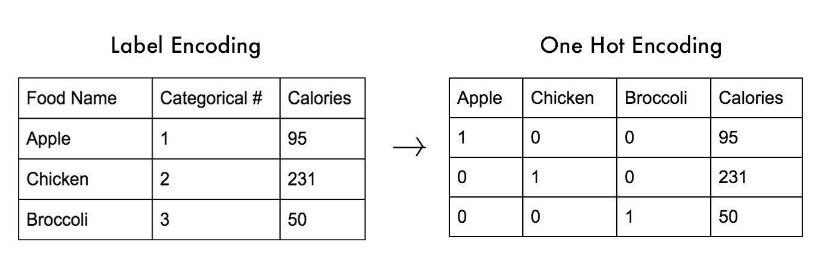
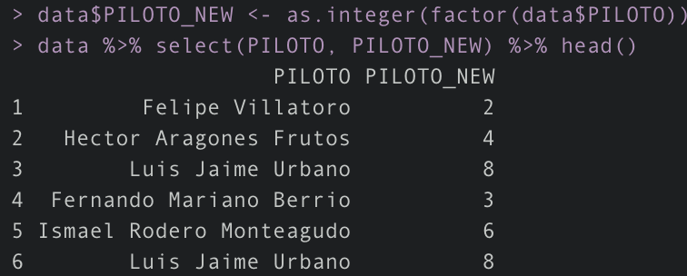
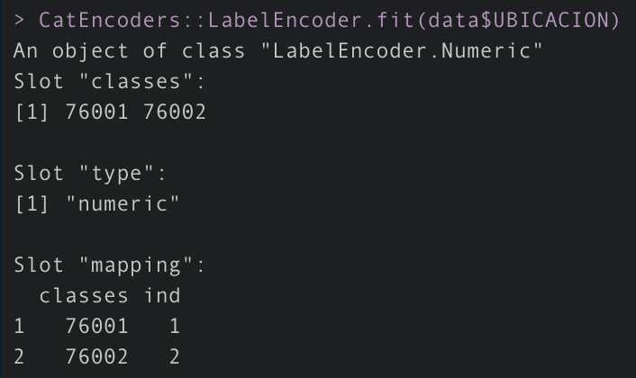
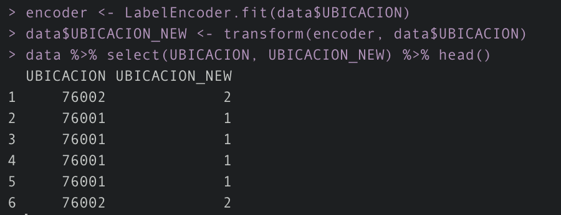
Label Encoding
Label encoders allow us to transform a categorical variable to a numerical variable.
Some frameworks only allow numeric variables (Tensorflow, Keras, Pytorch)
Useful for transforming y into classification models.
CatEncoders

Slide 26
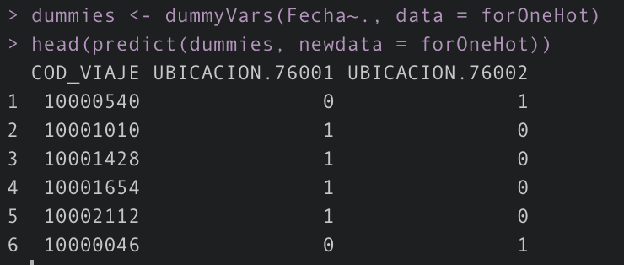
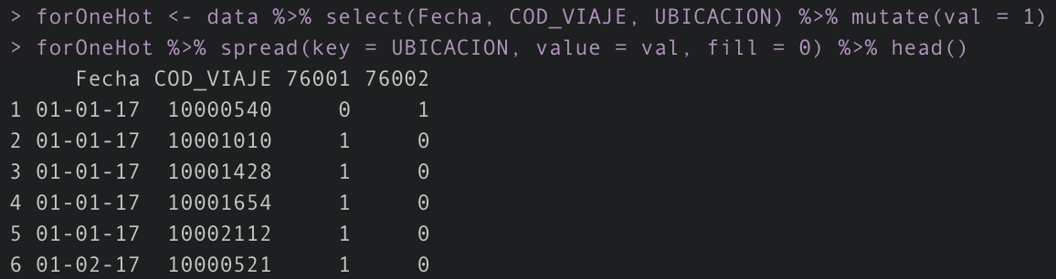
One Hot Encoding
Used to transform a categorical variable into as many binary vectors as categories (levels)
Why “One Hot”?
Dummy variables are used to fit models, allowing to assume a natural ordering between categories. Some of them are present and some aren’t.
Giving a computer categorical variables is talking in a different language that the machine doesn’t understand.
caret

Slide 27

GloVe (Global Vectors)
Ratios of word-word co-occurrence probabilities have the potential for encoding some form of meaning which can be encoded as vector differences.
Pre-trained library; GloVe is designed in order that such vector differences capture as much as possible the meaning specified by the juxtaposition of two words.

Slide 28


Skipgrams and Bag of Words (n-grams)
The ‘n’ in n-grams is usually considered a number. So, for example, a 2-gram search will find all 2-item contiguous sequences in a corpus, while a 5-gram search will find all 5-item contiguous sequences in a corpus.
Whereas an n-gram search can only find patterns such as [A+B], skipgrams can find both [A+B] and [A+C+B]. That is, they can find collocates even when there is variety in constituency. A skipgram would uncover “dirty money in politics” and “dirty money in our politics”

Slide 29
Agenda
1
Missing Data
2
Outliers
3
Normalization (Numerical Variables)
4
Embeddings (Categorical Variables)
5
Splitting Sets

Slide 30

Train, Test, and Validation Sets
Train set is used to “train” the model (homework, labs, exercises, study)
Validation set is used to provide an unbiased validation (short examinations)
Test set is used to provide unbiased evaluation of a final model already trained (final exam)
*sample function in R
~80%
~20%

